Slide 1

Variables, Expressions and Statements
Mina Gabriel

Slide 2
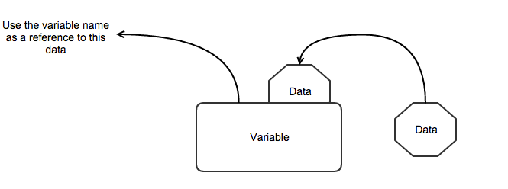
variable
One of the most powerful features of a programming language is the ability to manipulate variables.
A variable is a container that can store data.
A variable is a name that refers to a value.

Slide 3
variable
A variable is a container of information, which can change its value. It provides means for:
storing information.
retrieving the stored information.
modifying the stored information.
In programming, you will use variables to store and process information all the time.

Slide 4
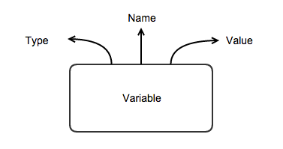
Characteristics of Variables
Variables are characterized by:
name (identifier), for example age;
type (of the information preserved in them), for example int;
value (stored information), for example 25.

Slide 5

Assignment Statements
An assignment statement creates a new variable and gives it a value:
This example makes three assignments.
The first assigns a string to a new variable named message;
the second gives the integer 17 to n;
the third assigns the (approximate) value of π to pi.

Slide 6
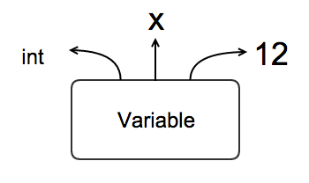
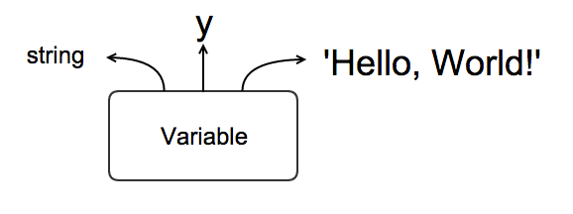
Exercise
login to your Linux machine
start a new terminal
type python + hit enter
initialize two variables:
x = 12
y = ‘Hello, World!’

Slide 7
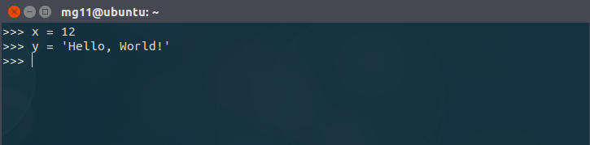
Answer

Slide 8
Variable Names
Programmers generally choose names for their variables that are meaningful.
Variable names can be as long as you like. They can contain both letters and numbers, but they can’t begin with a number. It is legal to use uppercase letters, but it is conventional to use only lowercase for variables names.

Slide 9
Variable Names
The underscore character, _, can appear in a name. It is often used in names with multiple words, such as
your_name
user_id
user_first_name

Slide 10
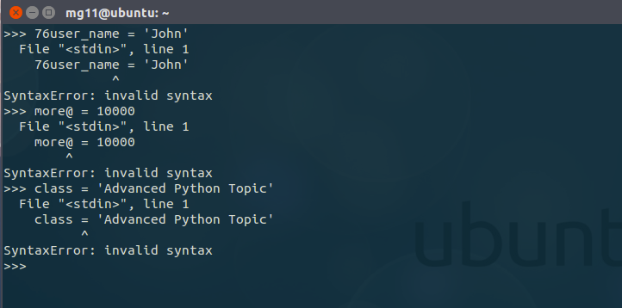
illegal variable names
If you give a variable an illegal name, you get a syntax error:
76user_name is illegal because it start with a number.
more@ is illegal because it contains an illegal character @
But what’s wrong with class??

Slide 11
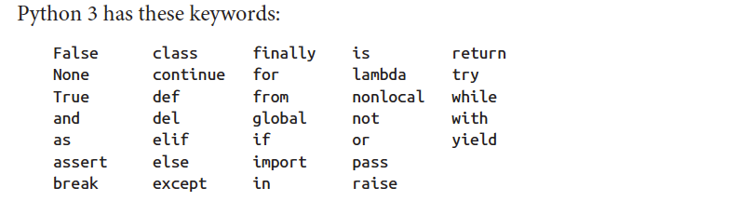
It turns out that class is one of reserved Python’s keywords. The interpreter uses keywords to recognize the structure of the program, and they cannot be used as variable names.
You don’t have to memorize this list. In most development environments, keywords are displayed in a different color; if you try to use one as a variable name, you’ll know.

Slide 12
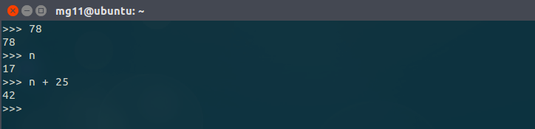
Expressions and Statements
An expression is a combination of values, variables, and operators. A value all by itself is considered an expression, and so is a variable, so the following are all legal expressions:
When you type an expression at the prompt, the interpreter evaluates it, which means that it finds the value of the expression. In this example, n has the value 17 and n + 25 has the value 42.

Slide 13
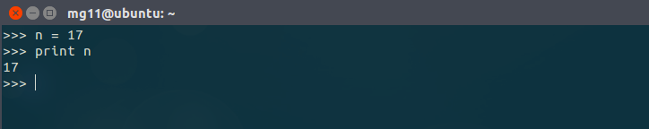
Statements
A statement is a unit of code that has an effect, like creating a variable or displaying a value.
The first line is an assignment statement that gives a value to n. The second line is a print statement that displays the value of n.
When you type a statement, the interpreter executes it, which means that it does whatever the statement says. In general, statements don’t have values.

Slide 14
Script Mode
So far we have run Python in interactive mode, which means that you interact directly with the interpreter. Interactive mode is a good way to get started, but if you are working with more than a few lines of code, it can be clumsy.
The alternative is to save code in a file called a script and then run the interpreter in script mode to execute the script.
By convention, Python scripts have names that end with .py.

Slide 15

Because Python provides both modes, you can test bits of code in interactive mode
before you put them in a script. But there are differences between interactive mode and script mode that can be confusing.
For example, if you are using Python as a calculator, you might type:
The first line assigns a value to miles, but it has no visible effect. The second line is an expression, so the interpreter evaluates it and displays the result. It turns out that a marathon is about 42 kilometers.

Slide 16

But if you type the same code into a script and run it, you get no output at all.
In script mode an expression, all by itself, has no visible effect.
Python actually evaluates the expression, but it doesn’t display the value unless you tell it to:

Slide 17
Start programming in script mode
first you need to create a new executable .py file
in this example I will use nano terminal text editor to create and edit the .py file.
when the file open in nano start adding your code
then hit CTRL + x to exit and save the file
when the file saved type
$ python + space + filename.py + hit enter

Slide 18
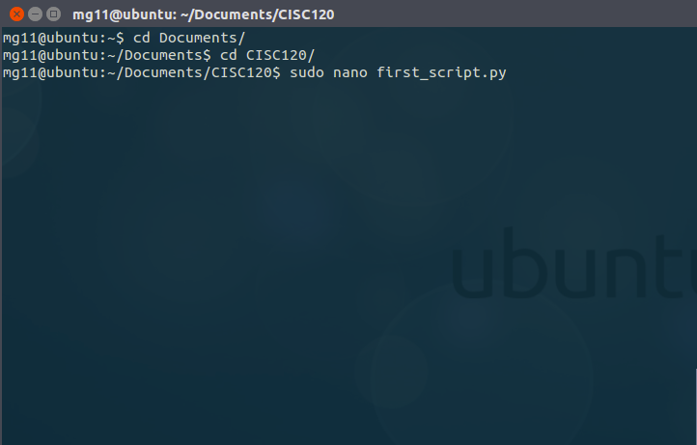
create a new python file

Slide 19
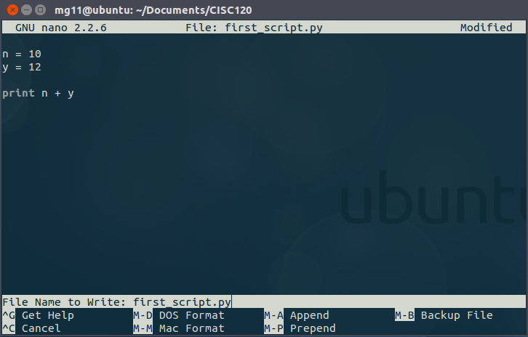
add your code

Slide 20
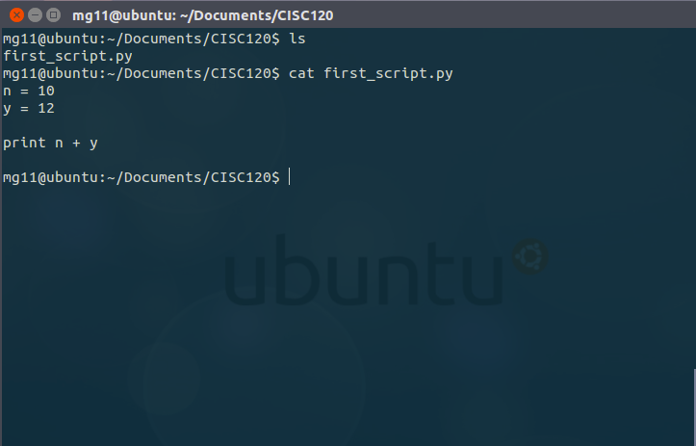
check that your file exists and it’s not empty
Use the cat command to print the file contents to the screen

Slide 21
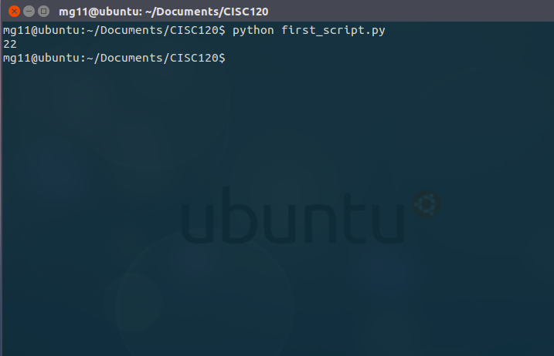
run your code

Slide 22
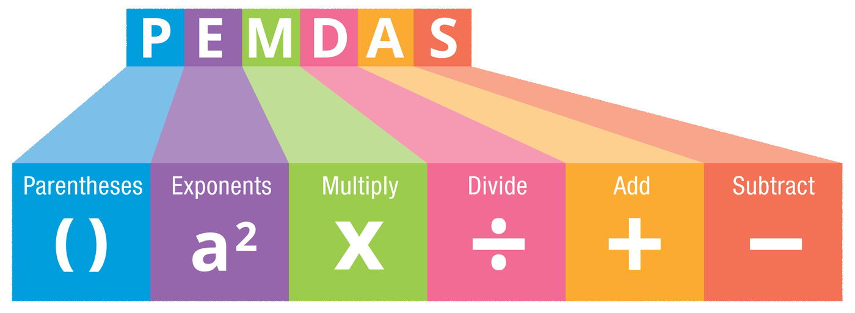
Order of Operations
When an expression contains more than one operator, the order of evaluation depends on the order of operations.
For mathematical operators, Python follows mathematical convention.

Slide 23
Parentheses have the highest precedence and can be used to force an expression to evaluate in the order you want. Since expressions in parentheses are evaluated first, 2 * (3-1) is 4, and (1+1)**(5-2) is 8. You can also use parentheses to make an expression easier to read, as in (minute * 100) / 60, even if it doesn’t change the result.

Slide 24
Exponentiation has the next highest precedence, so 1 + 2**3 is 9, not 27, and 2 * 3**2 is 18, not 36.

Slide 25
Multiplication and Division have higher precedence than Addition and Subtraction. So 2*3-1 is 5, not 4, and 6+4/2 is 8, not 5.

Slide 26
Operators with the same precedence are evaluated from left to right
So in the expression degrees / 2 * pi
the division happens first and the result is multiplied by pi.
To divide by 2π, you can use parentheses or write degrees / 2 / pi.

Slide 27
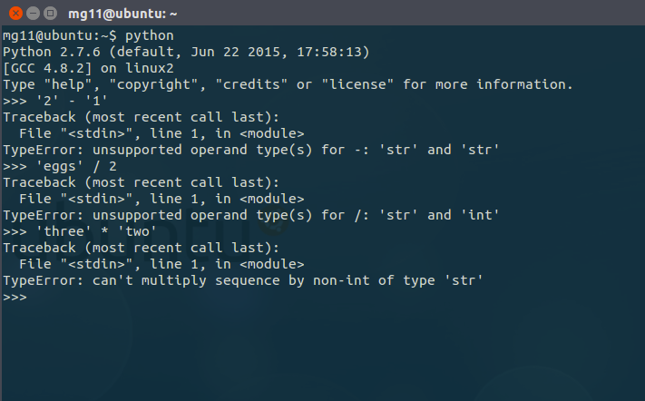
String Operations
In general, you can’t perform mathematical operations on strings, even if the strings look like numbers, so the following are illegal:

Slide 28
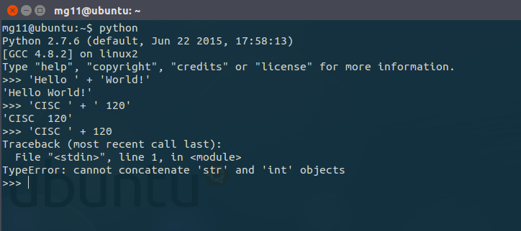
But there are two exceptions, + and *.
The + operator performs string concatenation, which means it joins the strings by linking them end-to-end. For example:

Slide 29
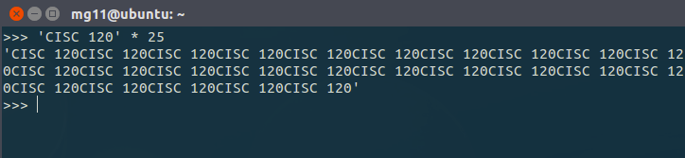
The * operator also works on strings; it performs repetition. For example:

Slide 30
Comments
As programs get bigger and more complicated, they get more difficult to read.
and it is often difficult to look at a piece of code and figure out what it is doing, or why.
For this reason, it is a good idea to add notes to your programs to explain in natural language what the program is doing.

Slide 31
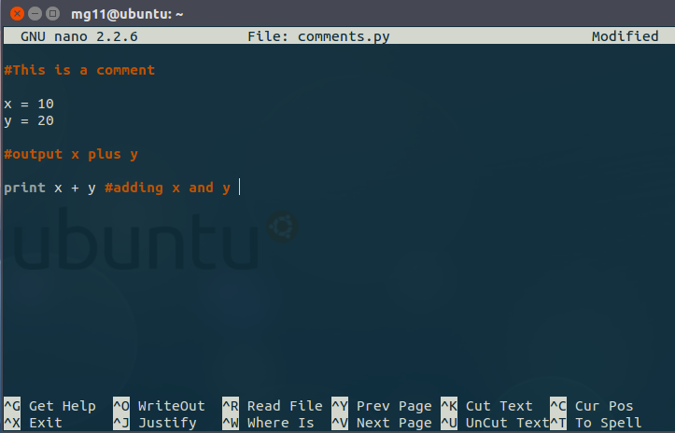
These notes are called comments, and they start with the # symbol:
Everything from the # to the end of the line is ignored—it has no effect on the execution of the program.

Slide 32
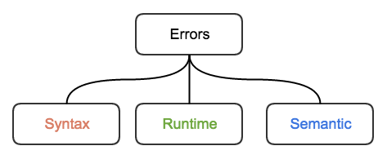
Debugging
Three kinds of errors can occur in a program: syntax errors, runtime errors, and semantic errors. It is useful to distinguish between them in order to track them down more quickly.

Slide 33
Syntax error:
“Syntax” refers to the structure of a program and the rules about that structure. For example, parentheses have to come in matching pairs, so (1 + 2) is legal, but 8) is a syntax error.
If there is a syntax error anywhere in your program, Python displays an error message and quits, and you will not be able to run the program.
During the first few weeks of your programming career, you might spend a lot of time tracking down syntax errors.
As you gain experience, you will make fewer errors and find them faster.

Slide 34
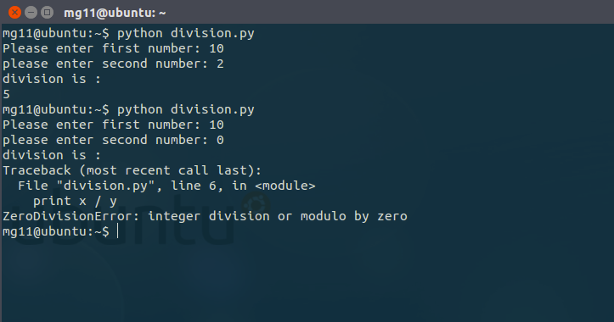
Runtime error:
The second type of error is a runtime error, so called because the error does not appear until after the program has started running. These errors are also called exceptions because they usually indicate that something exceptional (and bad) has happened.

Slide 35
Semantic error:
The third type of error is “semantic”, which means related to meaning. If there is a semantic error in your program, it will run without generating error messages, but it will not do the right thing. It will do something else. Specifically, it will do what you told it to do.

Slide 36
Glossary
variable:
A name that refers to a value.
assignment:
A statement that assigns a value to a variable.
state diagram:
A graphical representation of a set of variables and the values they refer to.
keyword:
A reserved word that is used to parse a program; you cannot use keywords like if, def, and while as variable names.
expression:
A combination of variables, operators, and values that represents a single result.
evaluate:
To simplify an expression by performing the operations in order to yield a single value.

Slide 37
Glossary
statement:
A section of code that represents a command or action. So far, the statements we have seen are assignments and print statements.
execute:
To run a statement and do what it says.
interactive mode:
A way of using the Python interpreter by typing code at the prompt
script mode:
A way of using the Python interpreter to read code from a script and run it.
script:
A program stored in a file.

Slide 38
Glossary
order of operations:
Rules governing the order in which expressions involving multiple operators and operands are evaluated.
concatenate:
To join two operands end-to-end.
comment:
Information in a program that is meant for other programmers (or anyone reading the source code) and has no effect on the execution of the program.

Slide 39
Glossary
syntax error:
An error in a program that makes it impossible to parse (and therefore impossible to interpret).
exception error:
An error that is detected while the program is running.
semantic error:
An error in a program that makes it do something other than what the programmer intended.

Slide 40
Exercise
We’ve seen that n = 42 is legal. What about 42 = n?
How about x = y = 1?
How many miles are there in 10 kilometers? Hint: there are 1.61 kilometers in a mile.
In some languages every statement ends with a semicolon, ;. What happens if you put a semicolon at the end of a Python statement?
What if you put a period at the end of a statement?
In math notation you can multiply x and y like this: xy. What happens if you try that in Python?

Slide 41

Exercise
The Area of a Circle is $A=πr^{2}$ or$A=π$ $r$ . $r$ what is the area of a circle with radius 10 ?
$π$ = 3.14159

Slide 42

Exercise
The volume of a sphere with radius r is $\frac{4}{3}πr^{3}$. What is the volume of a sphere with radius 5?
$π$ = 3.14159

